Slide 1
Tutorial 7
Statistical Computation and Analysis
Spring 2026

Slide 2
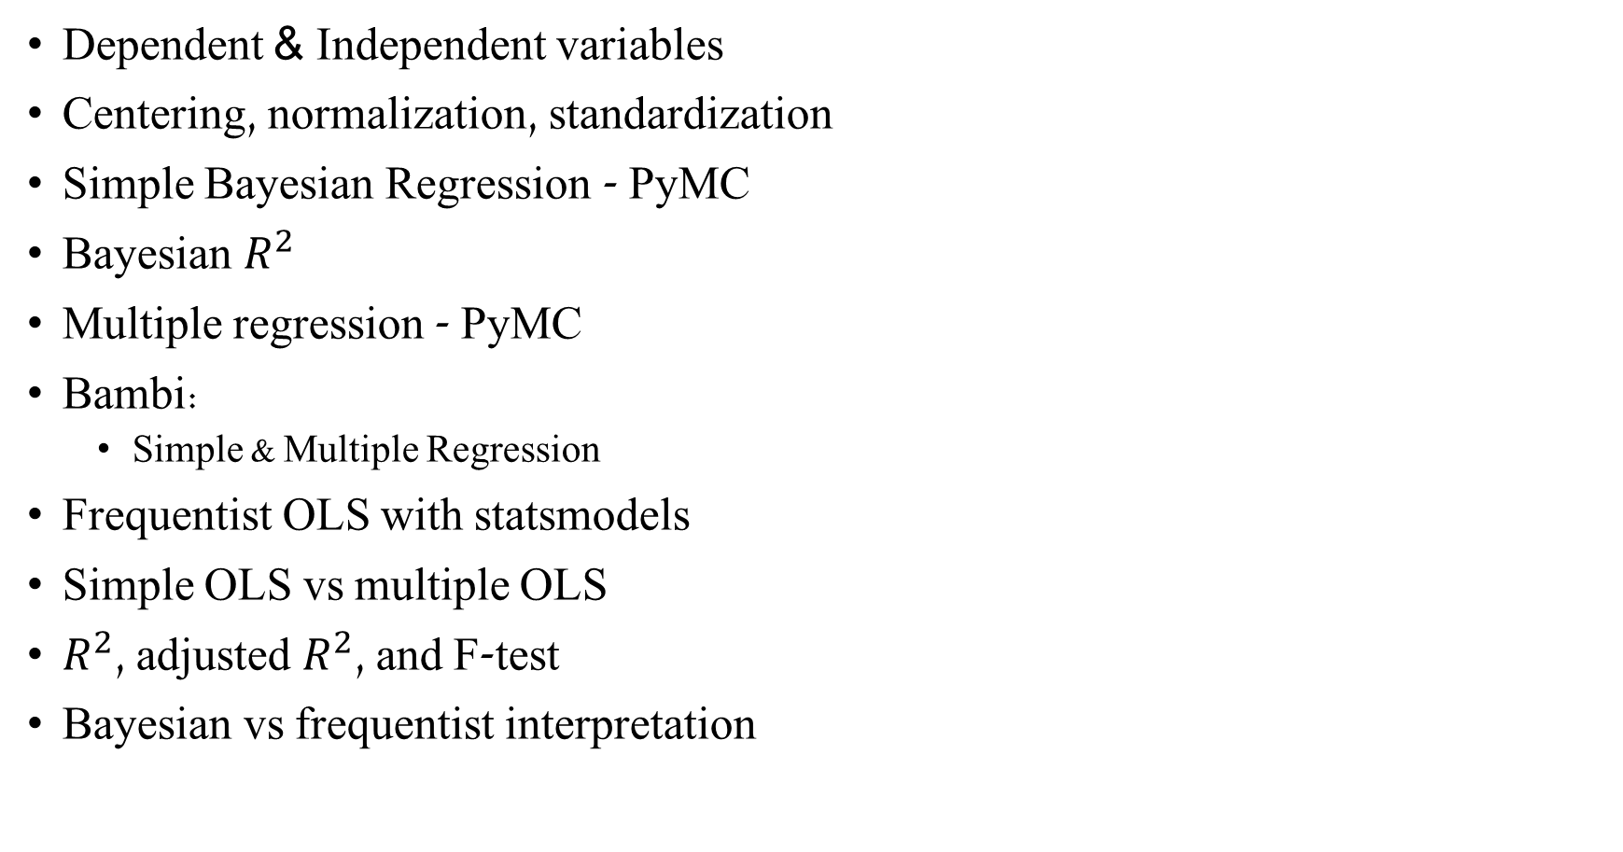
Tutorial Outline
Dependent & Independent variables
Centering, normalization, standardization
Simple Bayesian Regression - PyMC
Bayesian $R^{2}$
Multiple regression - PyMC
Bambi:
Simple & Multiple Regression
Frequentist OLS with statsmodels
Simple OLS vs multiple OLS
$R^{2}$, adjusted $R^{2}$, and F-test
Bayesian vs frequentist interpretation

Slide 3
Variables Types & Transformations

Slide 4
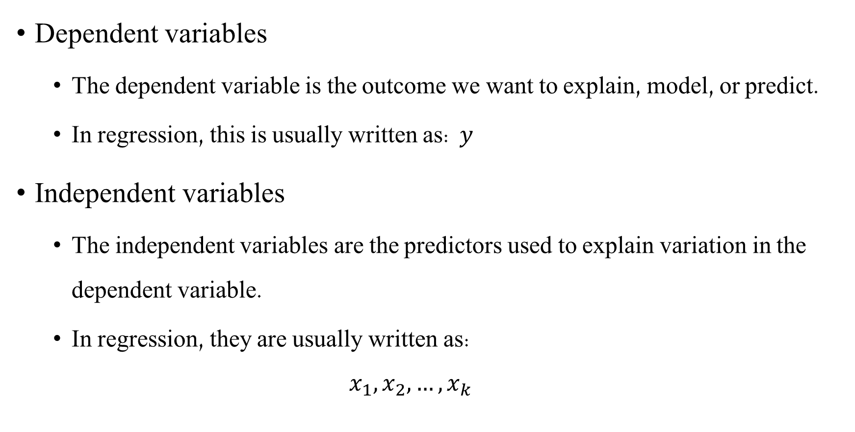
Dependent & Independent variables
Dependent variables
The dependent variable is the outcome we want to explain, model, or predict.
In regression, this is usually written as: $y$
Independent variables
The independent variables are the predictors used to explain variation in the dependent variable.
In regression, they are usually written as:
$$x_{1}​,x_{2}​,…,x_{k} ​$$
Notes:
In linear regression, the Normal likelihood is about the dependent variable:
$$y_{i}∣x_{i}∼Normal\left(μ_{i} , σ\right)$$
It is not an assumption that the independent variable $x$is normally distributed.
The predictor $x$is treated as known input to the model.

Slide 5
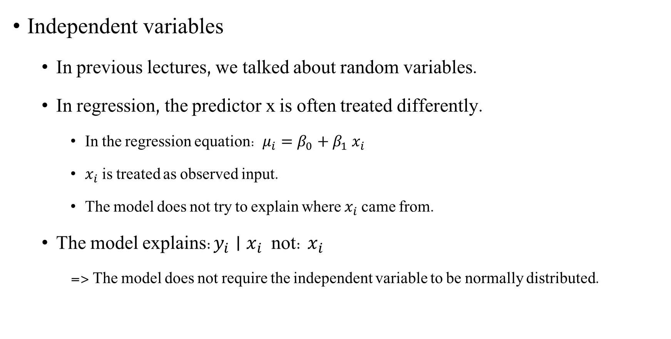
Dependent & Independent variables
Independent variables
In previous lectures, we talked about random variables.
In regression, the predictor x is often treated differently.
In the regression equation: $μ_{i}​=β_{0}​+β_{1} ​x_{i}$
$​x_{i}$​ is treated as observed input.
The model does not try to explain where $x_{i}$ came from.
The model explains:$y_{i}∣x_{i}$ not: $x_{i}$ ​
=> The model does not require the independent variable to be normally distributed.
Notes:
In linear regression, the Normal likelihood is about the dependent variable:
$$y_{i}∣x_{i}∼Normal\left(μ_{i} , σ\right)$$
It is not an assumption that the independent variable $x$is normally distributed.
The predictor $x$is treated as known input to the model.

Slide 6
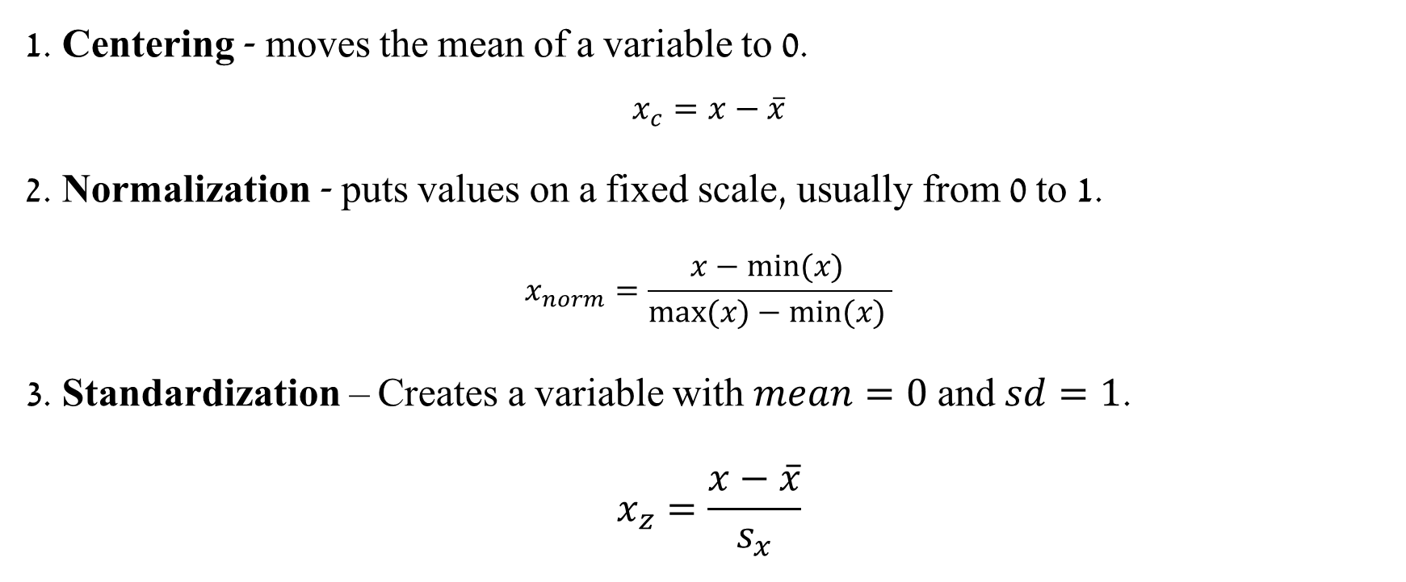
Three Common Transformations
1. Centering - moves the mean of a variable to 0.
$$x_{c}=x−\overline{x}$$
2. Normalization - puts values on a fixed scale, usually from 0 to 1.
$$x_{norm}​=\frac{x−min⁡(x)​ }{max⁡(x)−min⁡(x) }$$
3. Standardization – Creates a variable with $mean=0$ and $sd=1$.
$$x_{z}=\frac{x−\overline{x}}{s_{x}}$$

Slide 7
Simple Linear Regression

Slide 8
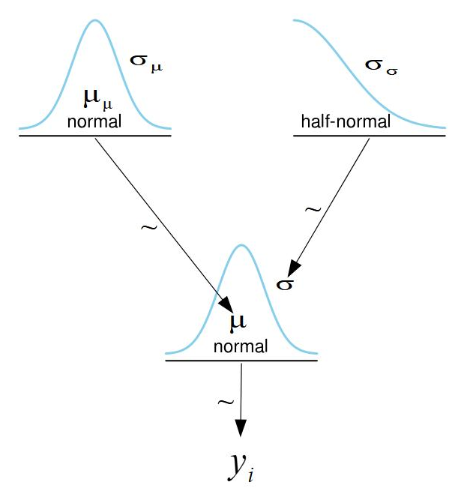

Simple Linear Regression
We have learned about normal models.
$$y_{i}\sim N\left(μ, σ\right)$$
$$μ\sim N\left(μ_{μ}, σ_{μ}\right)$$
$$σ\sim HalfNorm(σ_{σ})$$

Slide 9
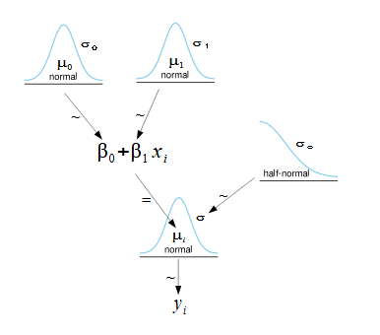
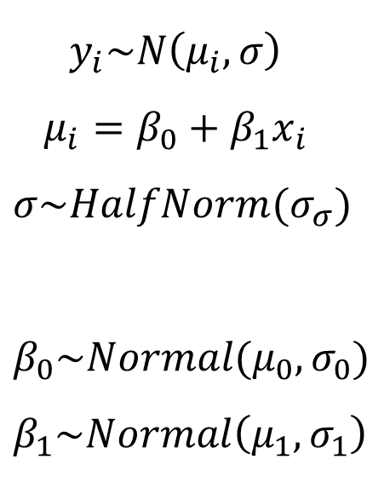
Simple Linear Regression
Now we’ll look at a case in which the mean depends on another variable.
$$y_{i}\sim N\left(μ_{i}, σ\right)$$
$$μ_{i}=β_{0}+β_{1}x_{i}$$
$$σ\sim HalfNorm(σ_{σ})$$
$$β_{0}\sim Normal(μ_{0},σ_{0})$$
$$β_{1}\sim Normal\left(μ_{1}, σ_{1}\right)$$

Slide 10
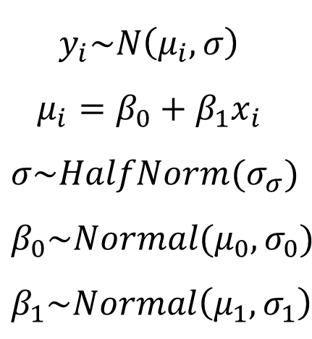

Simple Linear Regression
Normal Models Simple Linear Regression Model
$$y_{i}\sim N\left(μ_{i}, σ\right)$$
$$μ_{i}=β_{0}+β_{1}x_{i}$$
$$σ\sim HalfNorm(σ_{σ})$$
$$β_{0}\sim Normal(μ_{0},σ_{0})$$
$$β_{1}\sim Normal\left(μ_{1}, σ_{1}\right)$$
$$y_{i}\sim N\left(μ, σ\right)$$
$$μ\sim N\left(μ_{μ}, σ_{μ}\right)$$
$$σ\sim HalfNorm(σ_{σ})$$

Slide 11
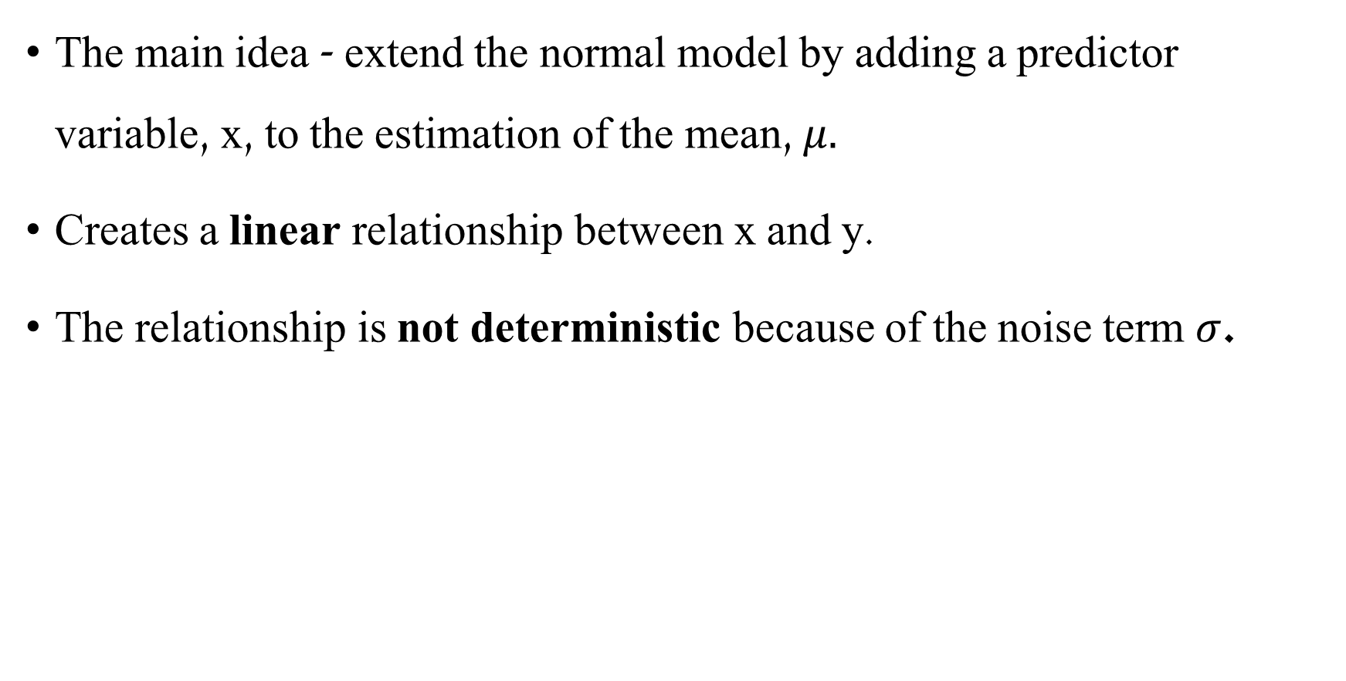

Simple Linear Regression
$$y_{i}\sim N\left(μ_{i}, σ\right)$$
$$μ_{i}=β_{0}+β_{1}x_{i}$$
The main idea - extend the normal model by adding a predictor variable, x, to the estimation of the mean, $μ.$
Creates a linear relationship between x and y.
The relationship is not deterministic because of the noise term $σ$.

Slide 12
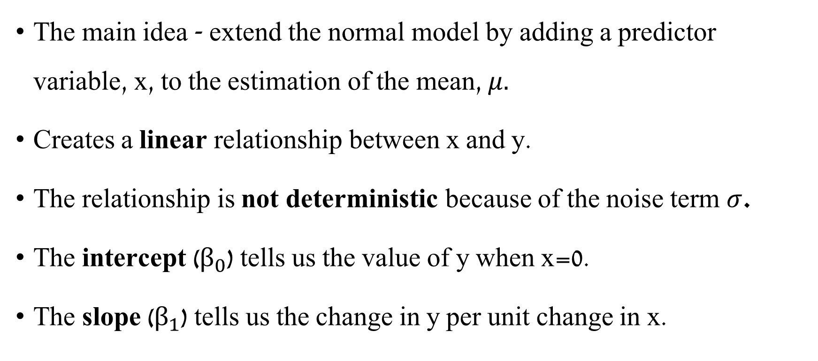

Simple Linear Regression
$$y_{i}\sim N\left(μ_{i}, σ\right)$$
$$μ_{i}=β_{0}+β_{1}x_{i}$$
The main idea - extend the normal model by adding a predictor variable, x, to the estimation of the mean, $μ.$
Creates a linear relationship between x and y.
The relationship is not deterministic because of the noise term $σ$.
The intercept ($β_{0}$) tells us the value of y when x=0.
The slope ($β_{1}$) tells us the change in y per unit change in x.

Slide 13
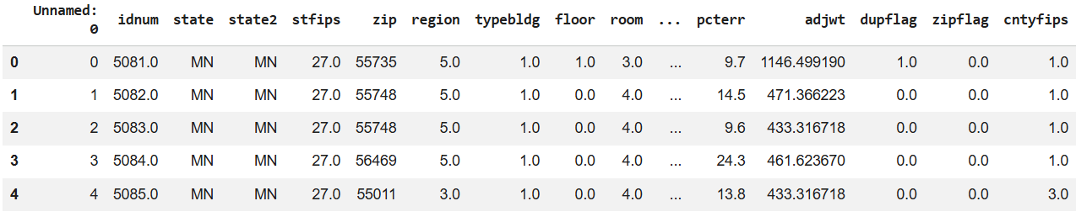
Simple Linear Regression
Raw Dataset
Main variables:
log_radon — log radon level, our dependent variable.
Uppm — county uranium level in ppm.
basement — whether the house has a basement (Y / N).
county — county name.

Slide 14
Variables Transformation for Linear Regression

Slide 15
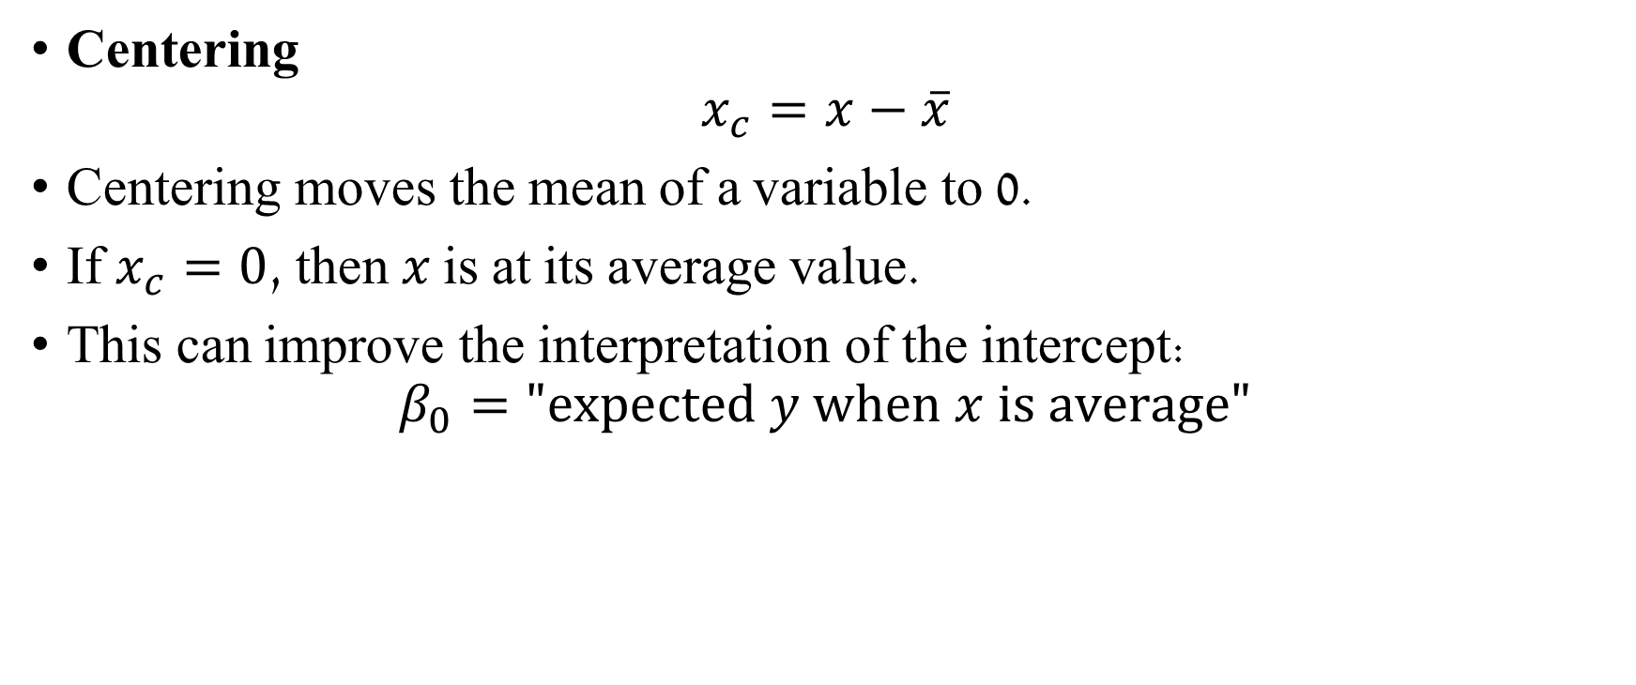
Centering, Normalization, & Standardization
Centering
$$x_{c}=x−\overline{x}$$
Centering moves the mean of a variable to 0.
If $x_{c}=0$, then 𝑥 is at its average value.
This can improve the interpretation of the intercept:
$$β_{0}="expected y when x is average"$$

Slide 16
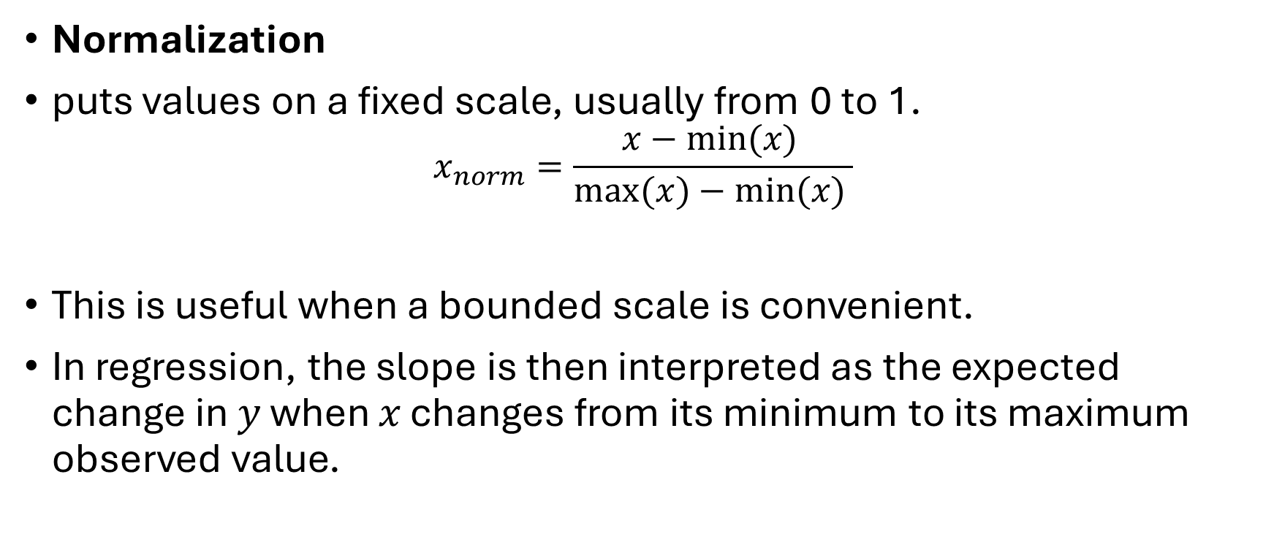
Centering, Normalization, & Standardization
Normalization
puts values on a fixed scale, usually from 0 to 1. $x_{norm}​=\frac{x−min⁡(x)​ }{max⁡(x)−min⁡(x) }$
This is useful when a bounded scale is convenient.
In regression, the slope is then interpreted as the expected change in 𝑦 when 𝑥 changes from its minimum to its maximum observed value.

Slide 17
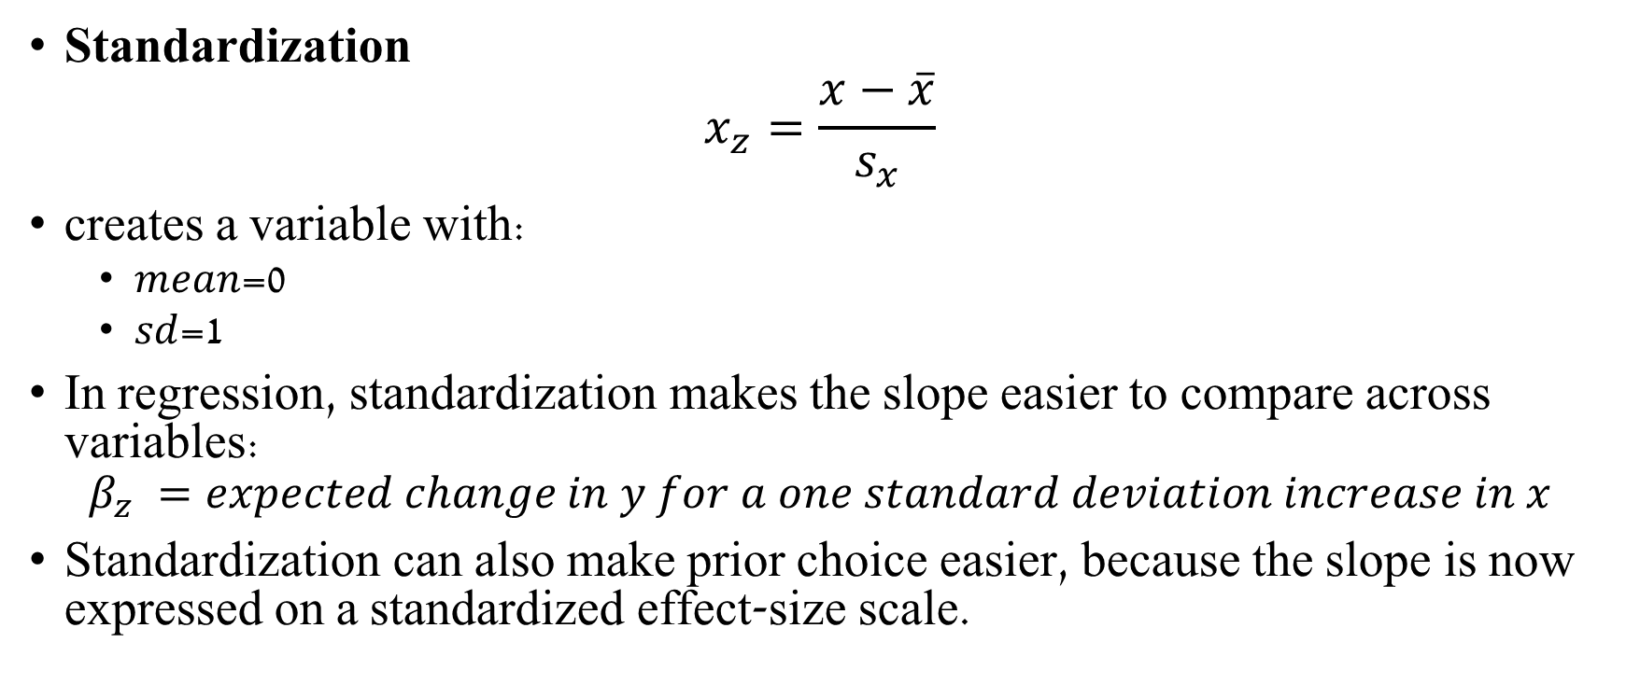
Centering, Normalization, & Standardization
Standardization
$$x_{z}=\frac{x−\overline{x}}{s_{x}}$$
creates a variable with:
𝑚𝑒𝑎𝑛=0
𝑠𝑑=1
In regression, standardization makes the slope easier to compare across variables:
$$β_{z} ​=expected change in y for a one standard deviation increase in x$$
Standardization can also make prior choice easier, because the slope is now expressed on a standardized effect-size scale.

Slide 18
Simple Linear Regression
Clean\transformed data variables for the model:
We keep rows with known basement status and the variables needed for the regression models.
We create:
y = log_radon, log-transformed radon level
log_uranium = log-transformed uranium level
uranium_c = centered log uranium
uranium_z = standardized log uranium
basement_num = categorial variable: 1 for basement, 0 for no basement
Notes:
We’ll discuss categorial variables later in the tutorial
radon itself:
is always positive;
can contain a few houses or areas with very high values;
often has larger variability when the mean is larger;
may be poorly represented by a Normal model, because a Normal likelihood can generate negative radon values, which are not physically meaningful.
log_radon:
represents the same measurement, but on a different scale;
reduces the influence of very large values;
turns multiplicative differences into additive differences. For example, the change from 1 to 2 is similar to the change from 10 to 20 because both are a doubling;
is usually more appropriate for a Normal regression model, where we assume something like:
$$log⁡\left({\text{radon}}_{i}\right)∼\text{Normal}\left(μ_{i} , σ\right)$$

Slide 19
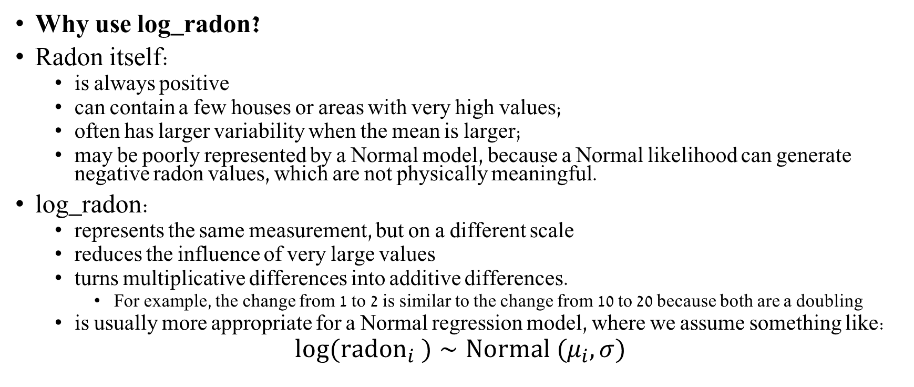
Simple Linear Regression
Why use log_radon?
Radon itself:
is always positive
can contain a few houses or areas with very high values;
often has larger variability when the mean is larger;
may be poorly represented by a Normal model, because a Normal likelihood can generate negative radon values, which are not physically meaningful.
log_radon:
represents the same measurement, but on a different scale
reduces the influence of very large values
turns multiplicative differences into additive differences.
For example, the change from 1 to 2 is similar to the change from 10 to 20 because both are a doubling
is usually more appropriate for a Normal regression model, where we assume something like:
$$log⁡({radon}_{i} )∼Normal (μ_{i},σ)$$

Slide 20
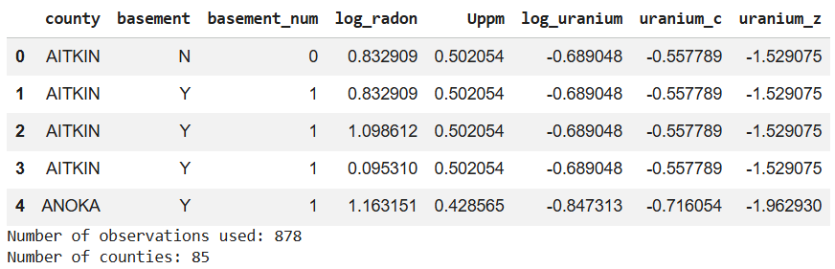
Simple Linear Regression
Clean variables:
Notes:
We’ll discuss categorial variables later in the tutorial

Slide 21
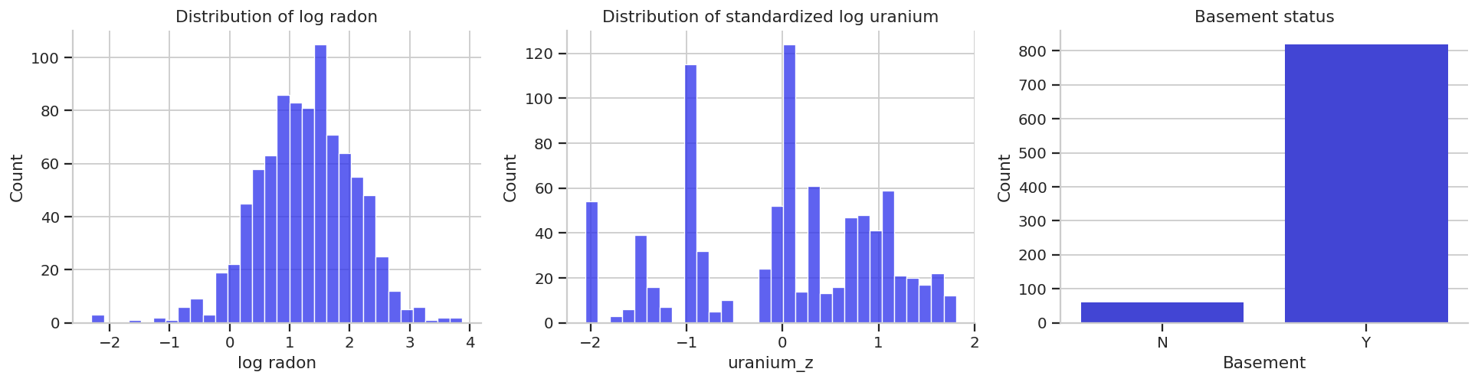
Simple Linear Regression
Visualization
Notes:
We’ll discuss categorial variables later in the tutorial

Slide 22
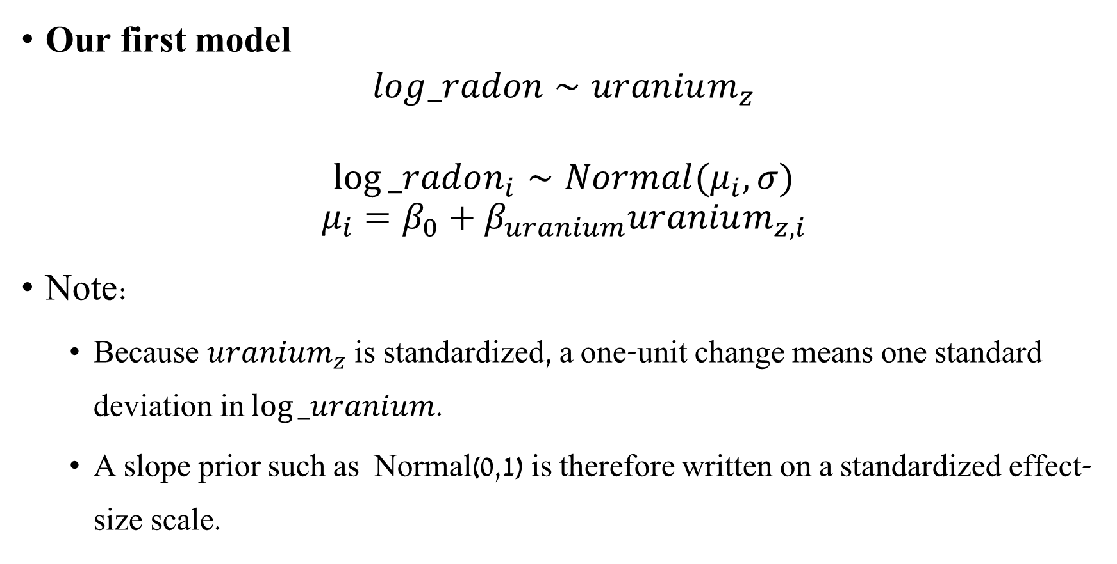
Simple Linear Regression
Statistical model notation:
log_radon is modeled as a linear function of standardized log uranium
Our first model
$$log_radon∼uranium_{z}$$
$$log⁡_radon_{i}∼Normal(μ_{i}​,σ)$$
$$μ_{i}=β_{0}+β_{uranium}uranium_{z,i}$$
Note:
Because $uranium_{z}$ is standardized, a one-unit change means one standard deviation in $log⁡_uranium$.
A slope prior such as Normal(0,1) is therefore written on a standardized effect-size scale.
Notes:
We’ll discuss categorial variables later in the tutorial

Slide 23
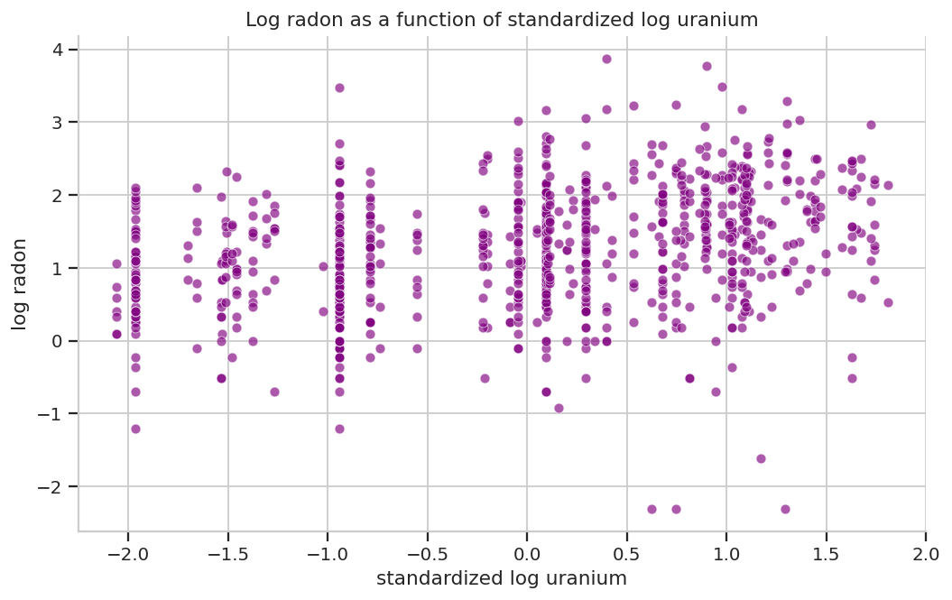
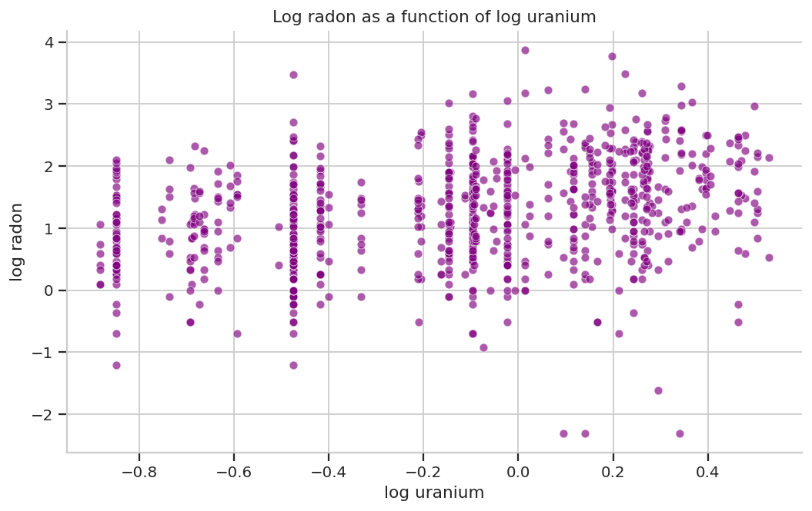
Simple Linear Regression
Visualization – Are radon levels related to county uranium levels?

Slide 24
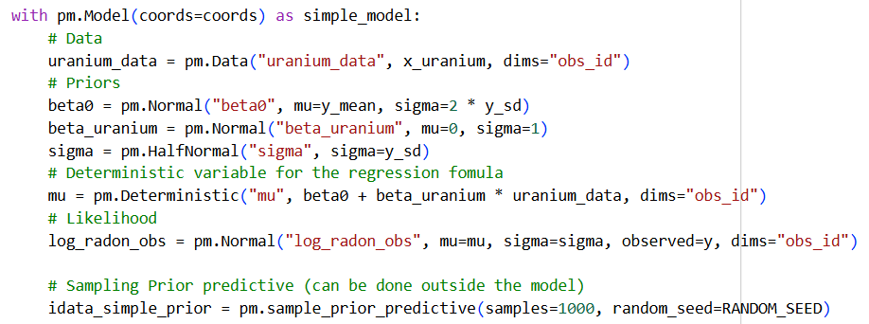
Simple Linear Regression
PyMC
Notes:
Because $uranium_{z}$ is standardized, a one-unit change means one standard deviation in $log⁡_uranium$.
A slope prior such as Normal(0,1) is therefore written on a standardized effect-size scale.

Slide 25
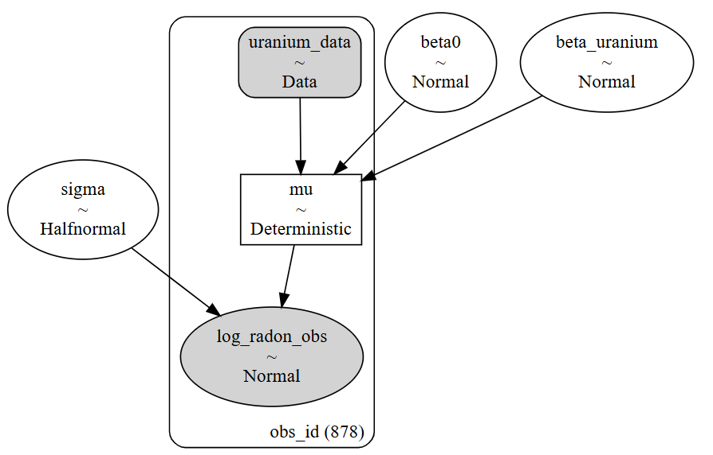
Simple Linear Regression
pm.model_to_graphviz(simple_model)
Notes:
Because $uranium_{z}$ is standardized, a one-unit change means one standard deviation in $log⁡_uranium$.
A slope prior such as Normal(0,1) is therefore written on a standardized effect-size scale.

Slide 26
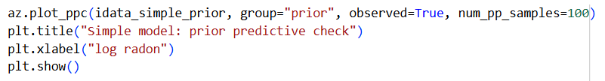
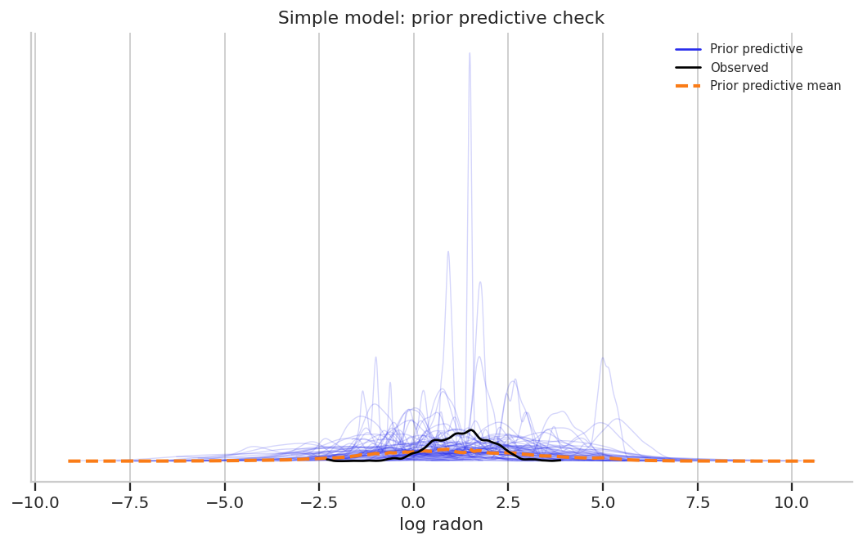
Simple Linear Regression
Prior Predictive
Notes:
The prior predictive check asks whether the model generates plausible log-radon values before seeing the data. This checks model coherence, not model fit.

Slide 27
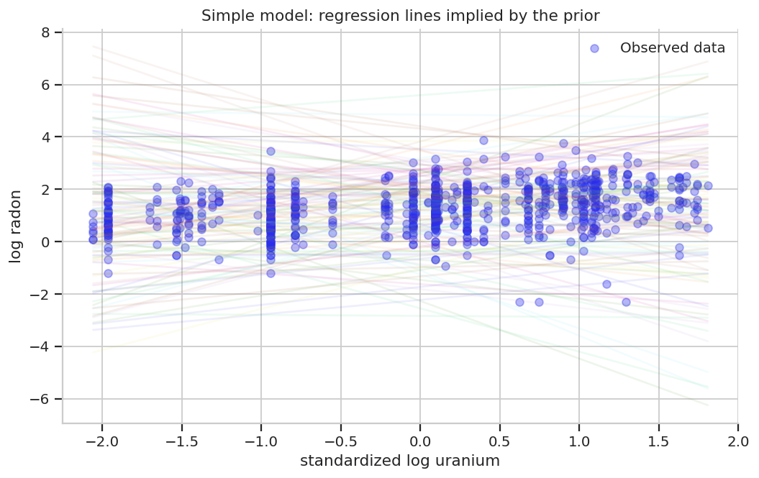
Simple Linear Regression
Prior Predictive
Possible regression lines calculated from the prior predictive samples.
Notes:
Each pair of possible $β_{0} ,β_{1}$ creates a possible line: $μ=β_{0}+β_{1}x$

Slide 28
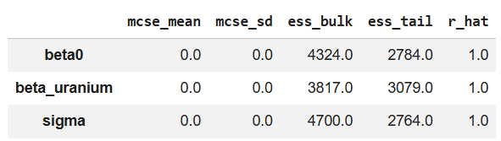
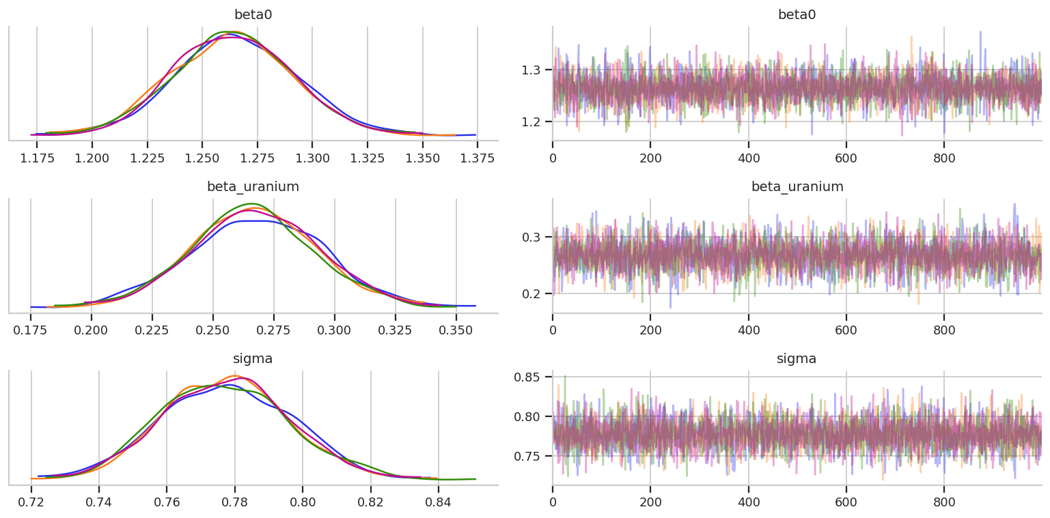
Simple Linear Regression
Sampling diagnostics
Summary
Trace plot

Slide 29
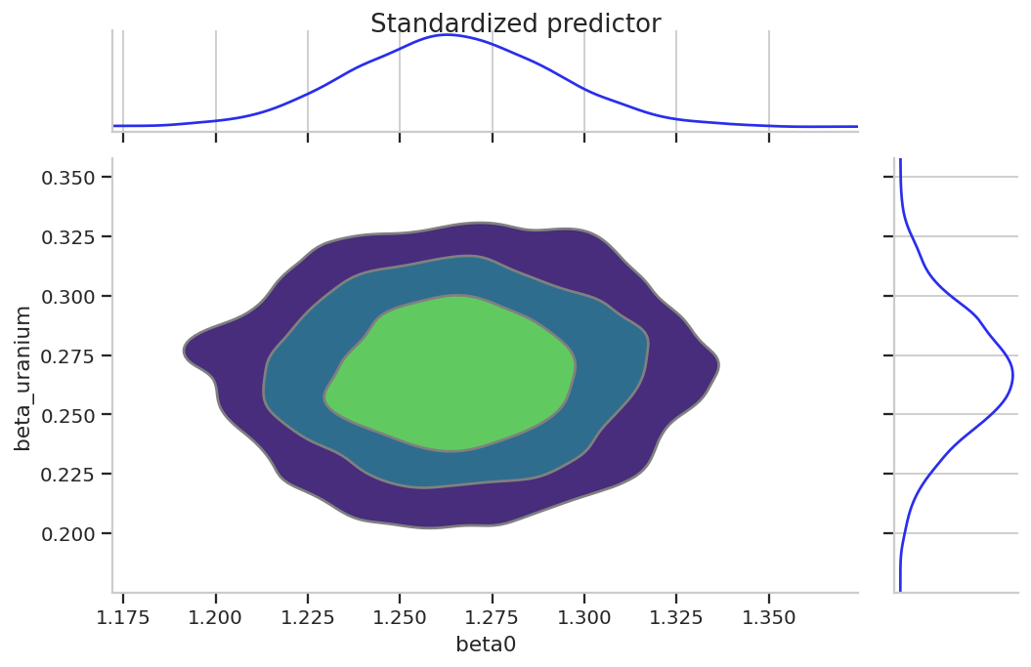
Simple Linear Regression
Sampling diagnostics
Pair plot

Slide 30
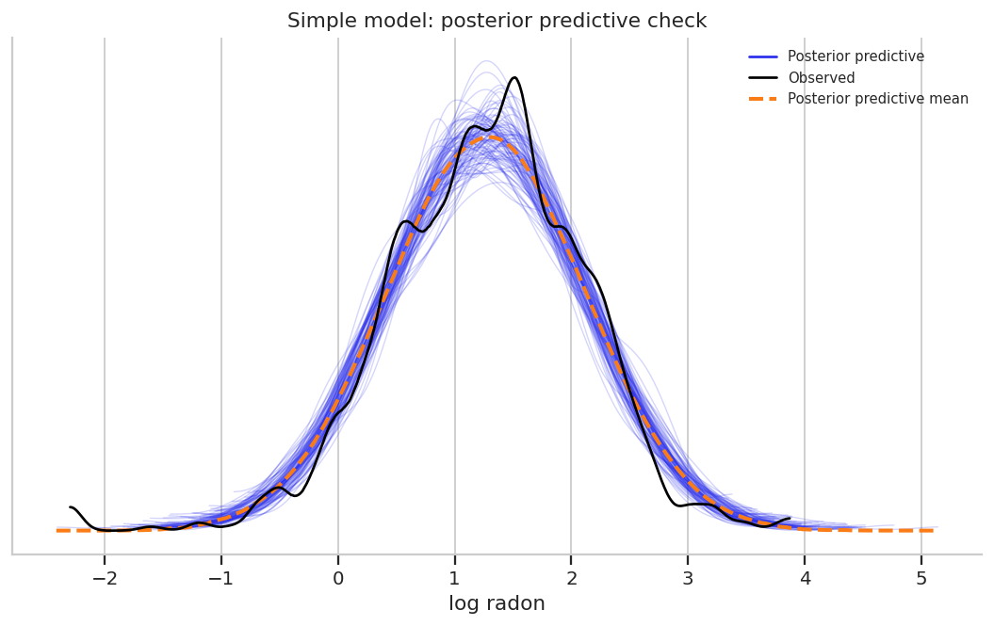
Simple Linear Regression
Posterior Predictive

Slide 31
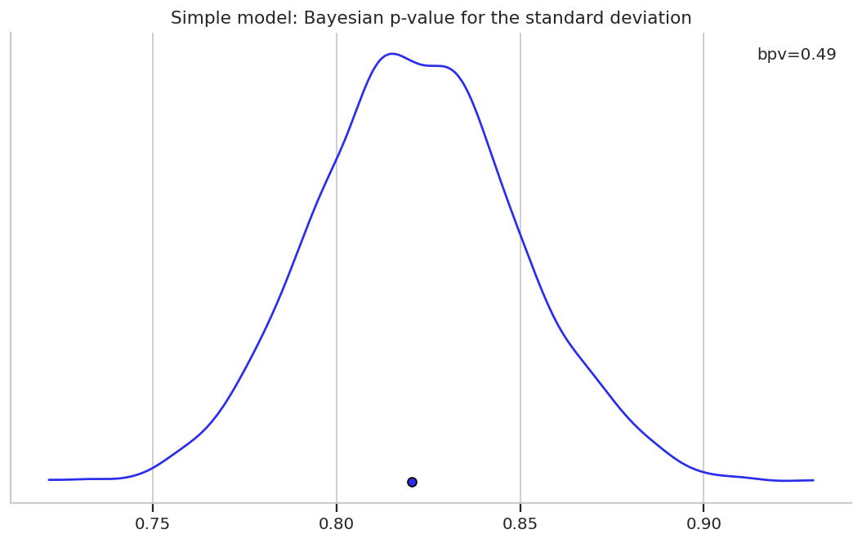
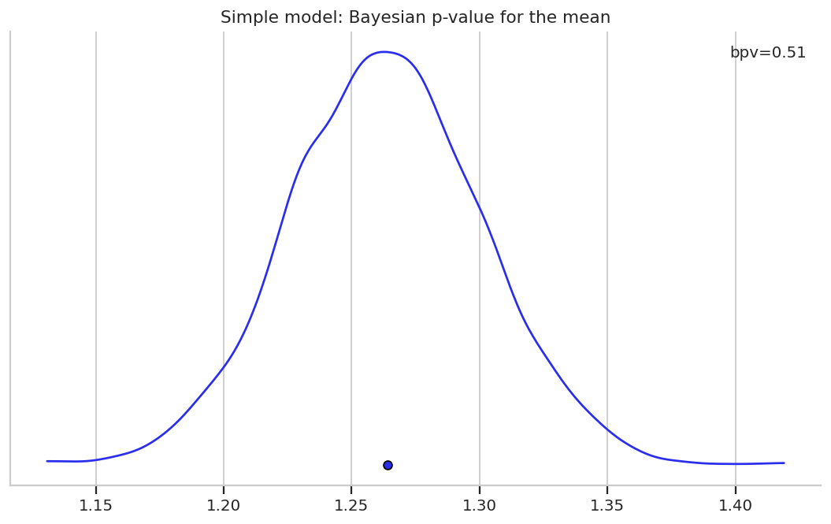
Simple Linear Regression
Bayesian p-value
Notes:
What percentage of posterior predictive values are less than actual data values?
We expect that it should be around half.
We get a distribution over posterior predictive sets.
Instead of comparing value by value, we can compare for chosen statistics, such as the mean and the standard deviation.
The dot is the value for our observed data.
The distributions are those of the statistic for each generated dataset.

Slide 32
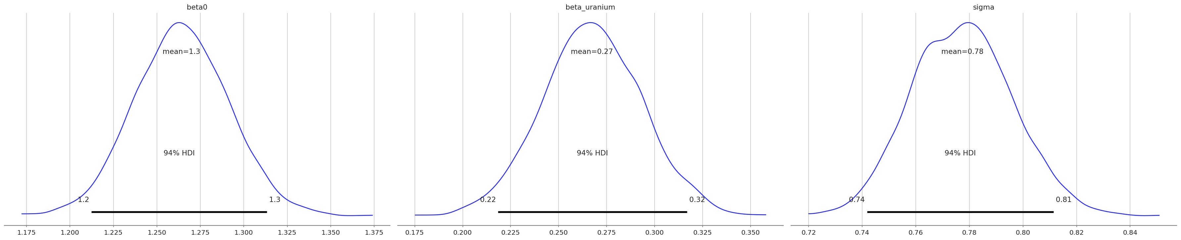

Simple Linear Regression
Posterior
The slope $β_{uranium}$is the expected change in$log⁡_radon$for a one-standard-deviation increase in log uranium.
Remember- in Bayesian regression, the slope is a posterior distribution, not one number.

Slide 33
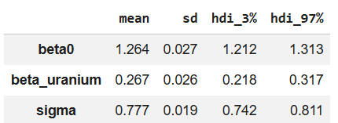

Simple Linear Regression
Posterior
The slope $β_{uranium}$is the expected change in$log⁡_radon$for a one-standard-deviation increase in log uranium.
Remember- in Bayesian regression, the slope is a posterior distribution, not one number.

Slide 34
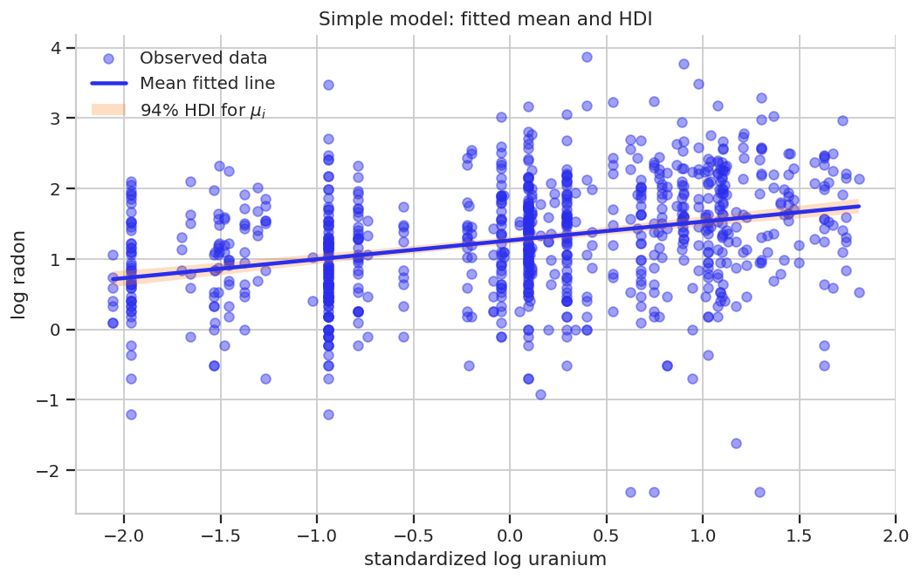
Simple Linear Regression
Posterior Predictive

Slide 35
Why center and standardize log uranium?

Slide 36
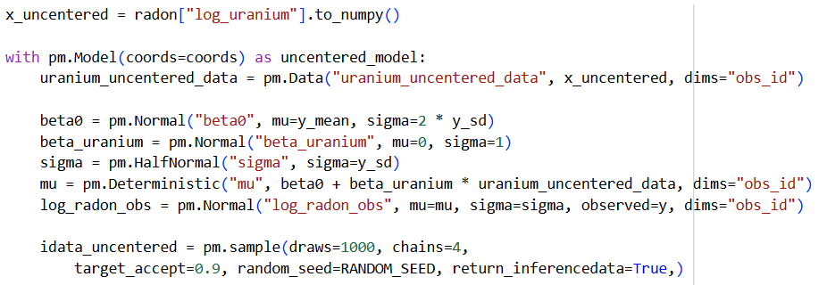
Simple Linear Regression
Why centering & standardize log_uranium matter?
Fit a similar simple model using the uncentered log_uranium predictor.
The intercept now refers to log_uranium = 0, not to the center of the data.
Notes:
We use standardized log uranium in the model.
Standardization includes centering, so the intercept refers to the expected log radon for an average log uranium value.
It also puts the slope on a standard-deviation scale, which helps prior choice and can improve sampling geometry.

Slide 37
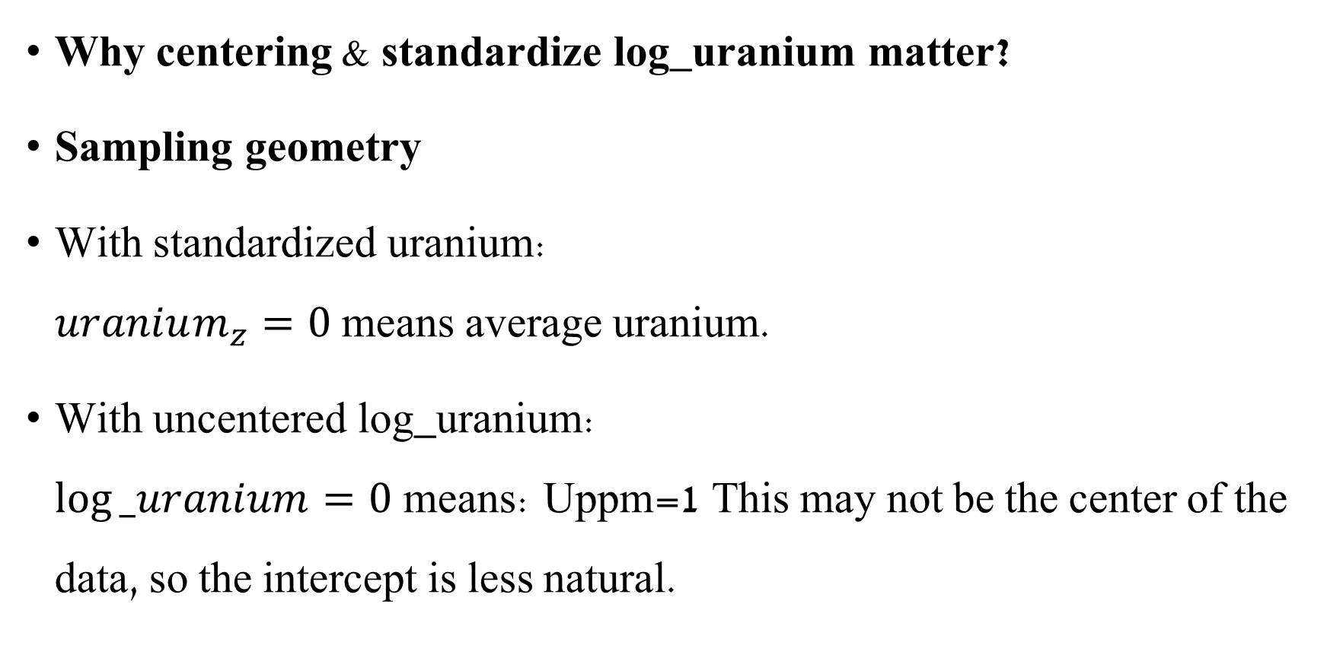
Simple Linear Regression
Why centering & standardize log_uranium matter?
Sampling geometry
With standardized uranium: $uranium_{z}=0$means average uranium.
With uncentered log_uranium: $log⁡_uranium=0$means: Uppm=1 This may not be the center of the data, so the intercept is less natural.
Notes:
Uppm=County uranium level in parts per million
We use standardized log uranium in the model.
Standardization includes centering, so the intercept refers to the expected log radon for an average log uranium value.
It also puts the slope on a standard-deviation scale, which helps prior choice and can improve sampling geometry.

Slide 38
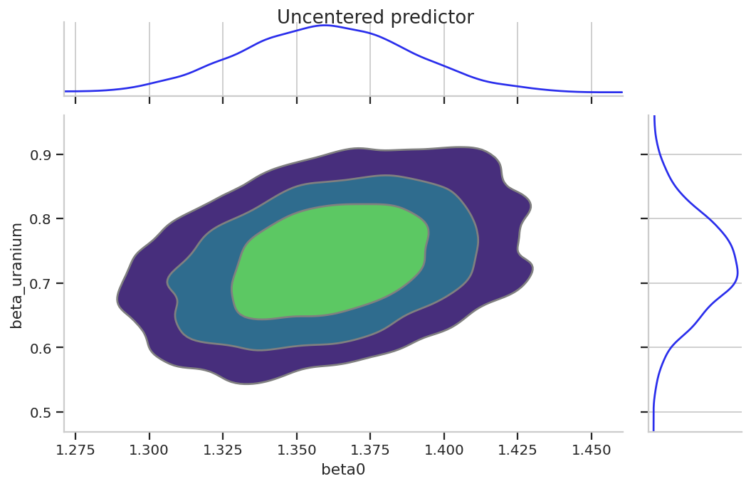
Simple Linear Regression
Sampling diagnostics
Pair plot

Slide 39
Simple Linear Regression
Uncentered predictors can create stronger posterior correlation between the intercept and slope.
This can make sampling less efficient, especially in more complex models.
Centering and standardization affect interpretation, prior choice, and sometimes sampling geometry.
Notes:
We use standardized log uranium in the model.
Standardization includes centering, so the intercept refers to the expected log radon for an average log uranium value.
It also puts the slope on a standard-deviation scale, which helps prior choice and can improve sampling geometry.

Slide 40
Multiple Regression

Slide 41

Multiple Regression
Multiple regression includes more than one predictor (independent variable).
For example, height as a function of both weight and age.
$μ_{height}=β_{0}+β_{weight}x_{weight}+$ $β_{age}x_{age}$

Slide 42
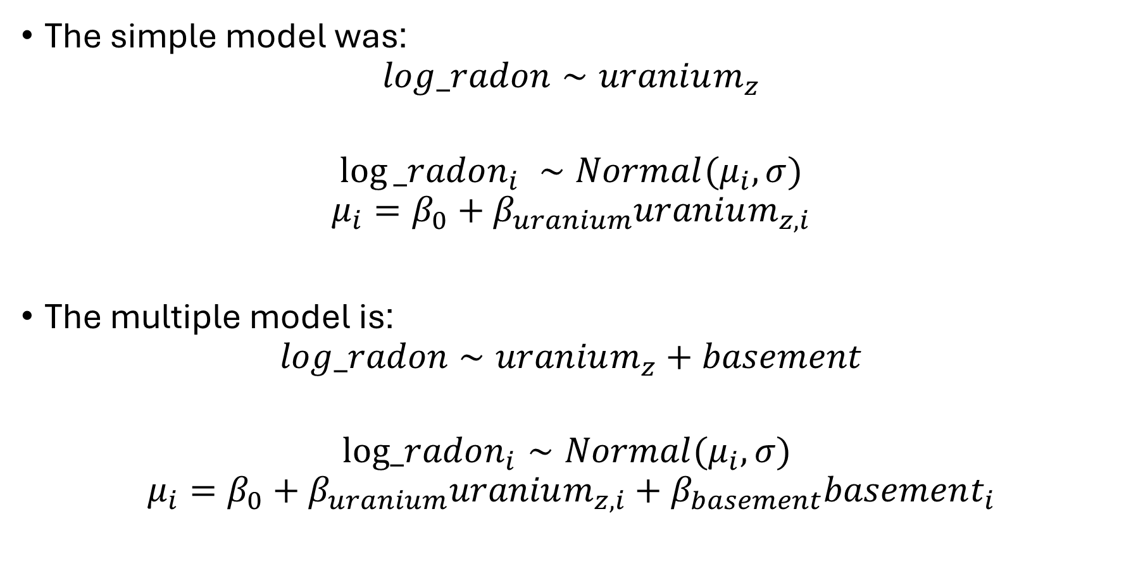
Multiple Regression
The simple model was:
$$log_radon∼uranium_{z}$$
$$log⁡_radon_{i} ∼Normal(μ_{i}​,σ)$$
$$μ_{i}=β_{0}+β_{uranium}uranium_{z,i}$$
The multiple model is:
$$log_radon∼uranium_{z}+basement$$
$$log_radon_{i}​∼Normal(μ_{i}​,σ)$$
$$μ_{i}=β_{0}+β_{uranium}uranium_{z,i}+β_{basement}basement_{i}$$

Slide 43
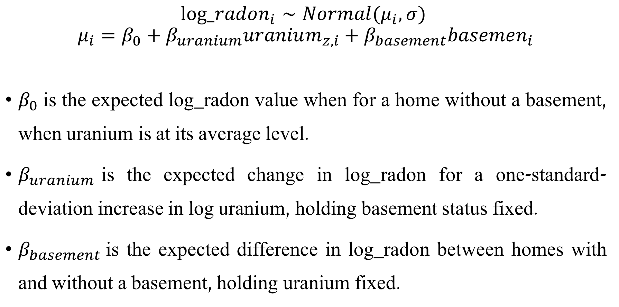
Multiple Regression
$$log_radon_{i}​∼Normal(μ_{i}​,σ)$$
$$μ_{i}=β_{0}+β_{uranium}uranium_{z,i}+β_{basement}basemen_{i}$$
$β_{0}$is the expected log_radon value when for a home without a basement, when uranium is at its average level.
$β_{uranium}$​is the expected change in log_radon for a one-standard-deviation increase in log uranium, holding basement status fixed.
$β_{basement}$is the expected difference in log_radon between homes with and without a basement, holding uranium fixed.
Notes:
In multiple regression, each slope is interpreted conditionally: it describes the association with one predictor while holding the other predictors fixed.

Slide 44

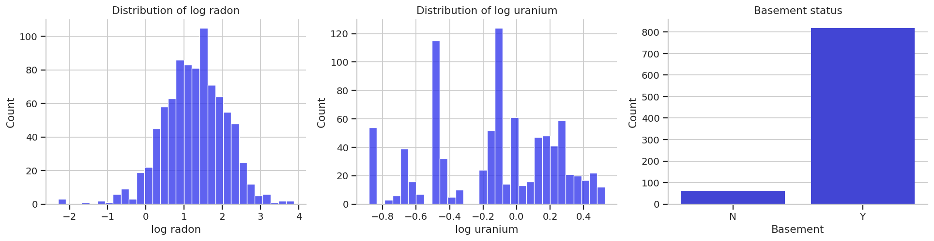
Simple Linear Regression
Visualization
Notes:
We’ll discuss categorial variables later in the tutorial

Slide 45
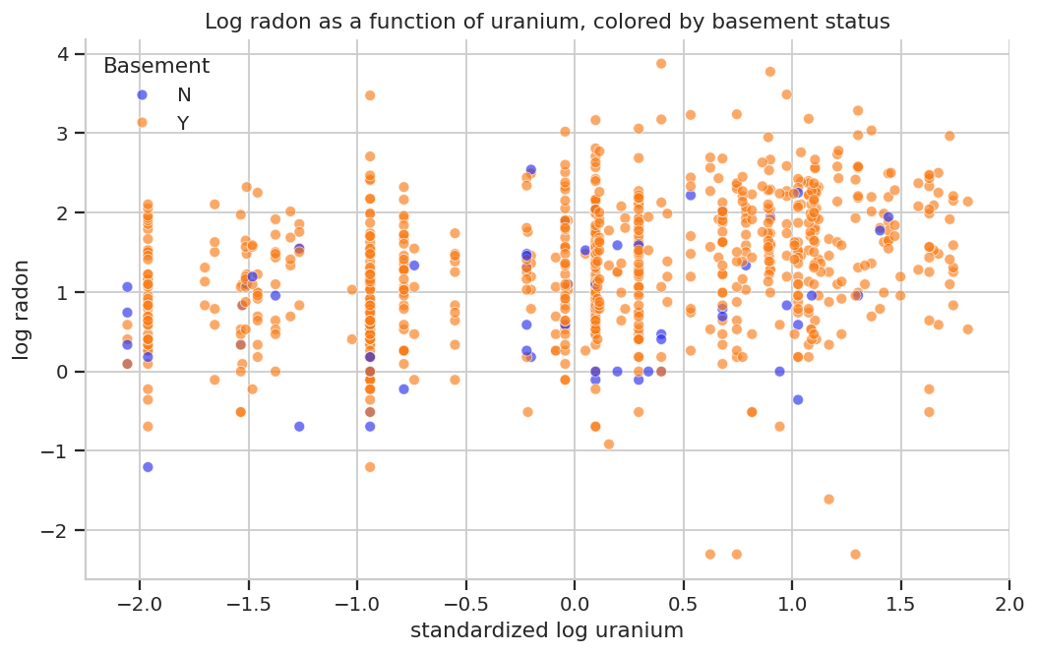
Multiple Regression
Data

Slide 46
Categorical Variables

Slide 47
Categorical variables
A categorical variable is a variable whose values are groups or labels, not numbers on a continuous scale.
Examples:
treatment group: control / treatment
sex: female / male / other
housing type: apartment / house
basement: no / yes

Slide 48
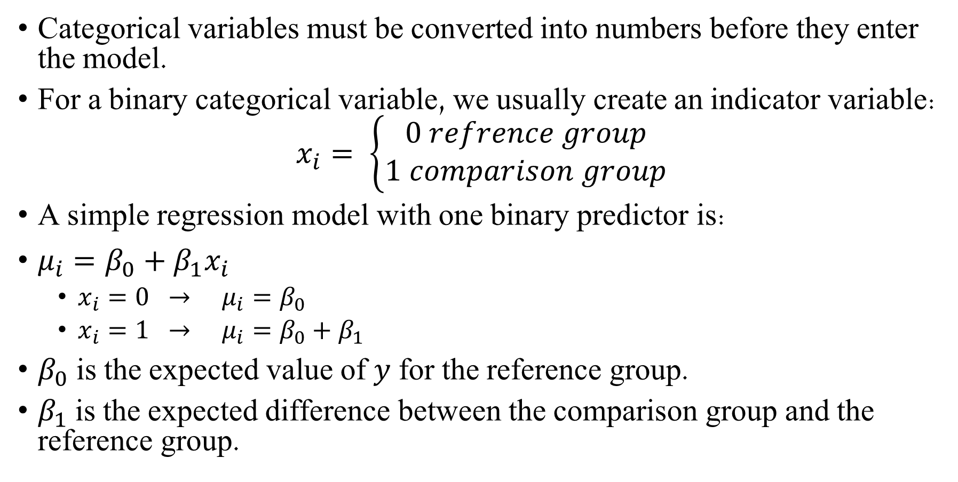
Categorical variables
Categorical variables must be converted into numbers before they enter the model.
For a binary categorical variable, we usually create an indicator variable:
$$x_{i}= \left\{\begin{aligned}0 refrence group \\ 1 comparison group\end{aligned}\right.$$
A simple regression model with one binary predictor is:
$μ_{i}=β_{0}+β_{1}x_{i}$
$x_{i}=0 → μ_{i}=β_{0}$
$x_{i}=1 → μ_{i}=β_{0}+β_{1}$
$β_{0}$is the expected value of $y$ for the reference group.
$β_{1}$is the expected difference between the comparison group and the reference group.
Notes:
The coding matters because the group coded as 0 becomes the reference group.

Slide 49
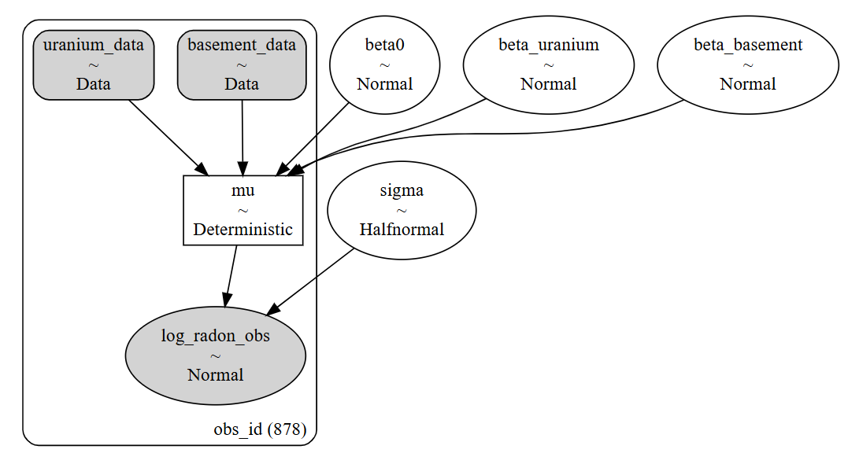

Multiple Regression
Model
$$log_radon_{i}​∼Normal(μ_{i}​,σ)$$
$$μ_{i}=β_{0}+β_{uranium}uranium_{z,i}+β_{basement}basement_{i}$$
$σ \sim HalfNormal(σ_{σ}$)
$$β_{uranium}\sim Normal(μ_{uranium},σ_{uranium})$$
$$β_{basement}\sim Normal\left(μ_{basement}, σ_{basement}\right)$$

Slide 50
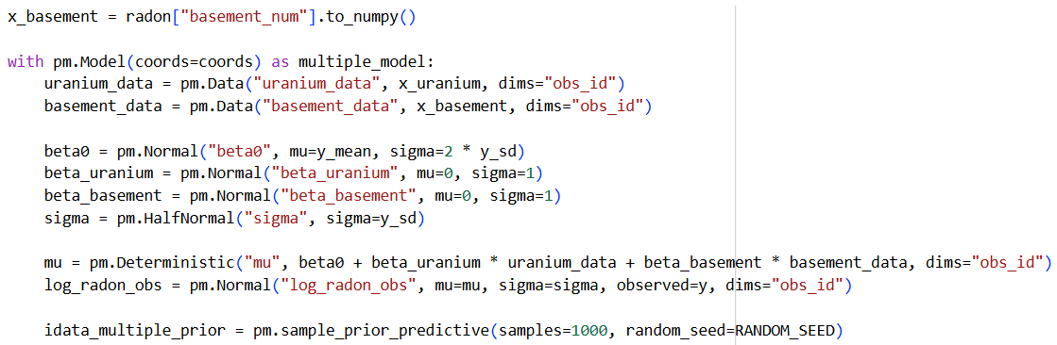
Multiple Regression
Model

Slide 51

Multiple Regression
Prior predictive check

Slide 52

Multiple Regression
Prior predictive check

Slide 53


Multiple Regression
Prior predictive check –

Slide 54


Multiple Regression
Sampling diagnostics

Slide 55

Multiple Regression
Sampling diagnostics

Slide 56

Multiple Regression
Posterior predictive

Slide 57


Multiple Regression
Posterior predictive
The posterior predictive HDI describes possible new observations, so it includes both uncertainty in the mean and residual variation around the mean.
Notes:
The posterior predictive HDI is much wider because it describes possible new observations, so it includes both uncertainty in the mean and residual variation around the mean.

Slide 58


Multiple Regression
Posterior
In multiple regression with a binary categorical predictor, there are two conditional regression lines:

Slide 59


Multiple Regression
Posterior

Slide 60

Multiple Regression
Posterior
In multiple regression with a binary categorical predictor, there are two conditional regression lines:

Slide 61

Bayesian $R^{2}$

Slide 62


Bayesian $R^{2}$
Summarizes explained variance by the model
$$R^{2}=\frac{Var\left(μ_{i}\right)}{Var(μ_{i})+σ^{2}}$$
Higher $R^{2}$ means more variance is explained by the fitted means.
It does not prove the model is correct.
It does not replace posterior predictive checks.
It is useful for comparing simple and multiple regression summaries.

Slide 63


Bayesian $R^{2}$
In Bayesian regression, each posterior draw gives a different fitted mean vector $μ_{i}$.
Therefore Bayesian $R^{2}$ is a posterior distribution.

Slide 64

Bayesian $R^{2}$

Slide 65


Bayesian $R^{2}$

Slide 66

https://bambinos.github.io/bambi/

Slide 67
Bambi
A high-level Bayesian model-building interface written on top of PyMC.
Designed to make it extremely easy to fit linear models.

Slide 68
PyMC vs. Bambi
Simple linear regression with PyMC
With Bambi:
The dependent variable is on the left and the independent on the right.

Slide 69
Bambi
What is bambi doing?
Bambi always standardize the data before modeling
Bambi assumes the likelihood is gaussian (can be changed).
We only specified how the dependent and independent variables are related.
Bambi automatically defines weakly informative priors.

Slide 70


Bambi
Relationship between dependent and independent variables
Likelihood
Corresponding link function
Dataset size
Linearly modelling the parameter mu of the Gaussian
Common level effects
Model Structure
Not linearly modeled parameters

Slide 71
Bambi
If we would like to set our own priors:
For:
The coefficient of the independent variable (the slope)
The sigma (the auxiliary parameter)
Define a dictionary and pass it to the model

Slide 72

Bambi

Slide 73


Bambi
If for some reason we don’t want an intercept
We can also omit the intercept from the model in two ways:
No intercept
Notes:
We usually keep the intercept in a regression model. Removing the intercept forces the fitted line to pass through zero, which is only appropriate when domain knowledge tells us that the expected outcome must be zero when all predictors are zero. In the radon model, this is not reasonable, because average uranium does not imply zero log radon.

Slide 74


Bambi
Let’s go back to our original model and look at the prior predictive check:
Notes:
Prior predictive
Reminder: Bambi defined those priors

Slide 75

Bambi
Sample it:

Slide 76

Bambi
Diagnostics and plotting as usual

Slide 77

Bambi
Diagnostics and plotting as usual

Slide 78


Bambi
Posterior predictive check:

Slide 79

Bambi
Posterior

Slide 80

Bambi
Multiple regression in Bambi:
Relationship between dependent and independent variables
Likelihood
Corresponding link function
Dataset size
Linearly modelling the parameter mu of the Gaussian
Common level effects
Model Structure
Not linearly modeled parameters

Slide 81

Bambi
Prior predictive
Notes:
Reminder: Bambi defined those priors

Slide 82



Bambi
Sampling & diagnostics

Slide 83

Bambi
Posterior predictive

Slide 84


Bambi
Posterior

Slide 85
Frequentist Simple Linear Regression

Slide 86
Frequentist linear regression
The frequentist model uses the same linear equation, but the interpretation changes:
Bayesian model: posterior distributions over parameters.
Frequentist OLS: point estimates, standard errors, confidence intervals, t-tests, and p-values.

Slide 87

Frequentist linear regression
Bayesian notation:
$$μ=Xβ$$
$$μ_{i}=β_{0}+β_{1}x_{1}+..+$$
$\text{β} \text{is} \text{the} \text{unknown} \text{parameter} \text{vector}\text{. }$
Frequentist notation:
$$\hat{y}=Xb \\ \hat{y}=b_{0}+b_{1}x_{1}+b_{2}x_{2}+…+b_{k}x_{k}$$
𝑏 is the estimator calculated from the data.
The fitted values are:
$b_{0}$: estimated intercept.
$b_{1}$: estimated slope.
Interpretation of the slope:
estimated change in 𝑦 for a one-unit increase in 𝑥.

Slide 88

Frequentist linear regression
Ordinary Least Squares (OLS)
OLS is the most common frequentist estimator for linear regression.
It chooses the regression line that makes the residuals as small as possible.
For each observation:
$$residual_{i} ​=y_{i} ​−{\hat{y}}_{i} ​$$
OLS minimize:
$$\sum_{i}{{\left(y_{i}​−{\hat{y}}_{i}​\right)}^{2} } ​$$
Meaning:
The model predicts ${\hat{y}}_{i}$.
The residual is the difference between the observed value and the predicted value.
OLS finds the line with the smallest sum of squared residuals.

Slide 89

Frequentist linear regression
We fit the same models using Ordinary Least Squares (OLS) with `statsmodels`.
After fitting, we will examine:
Estimate - the estimated coefficient, such as $b_{0}$ or $b_{1}$ ​
Standard error - uncertainty of the estimator across repeated samples
Confidence Interval - frequentist interval based on the sampling distribution
t-test and p-value - test whether one coefficient differs from 0
$R^{2}$- proportion of variability explained by the model
F-test - test whether the model as a whole explains more variability than a null model

Slide 90

Frequentist linear regression
We fit the same models using Ordinary Least Squares (OLS) with `statsmodels`.

Slide 91

Frequentist linear regression
Estimate - the estimated coefficient, such as $b_{0}$ or $b_{1}$ ​
Standard error - uncertainty of the estimator across repeated samples
Confidence Interval - frequentist interval based on the sampling distribution
t-test and p-value - test whether one coefficient differs from 0
Notes:
Key distinction:OLS gives estimates and tests. It does not give posterior distributions.

Slide 92



Frequentist linear regression
$$\hat{y}=b_{0}+b_{1}x_{1}$$
Estimate - the estimated coefficient, such as $b_{0}$ or $b_{1}$ ​
Standard error - uncertainty of the estimator across repeated samples
Confidence Interval - frequentist interval based on the sampling distribution
t-test and p-value - test whether one coefficient differs from 0
Notes:
Key distinction:OLS gives estimates and tests. It does not give posterior distributions.

Slide 93

Frequentist linear regression
$R^{2}$
linear regression, the model produces fitted values:
$${\hat{y}}_{i}$$
These are the values predicted by the regression model.
$R^{2}$ measures how much of the variability in y is explained by the fitted model:
$$R^{2}=\frac{var(\hat{y} ​)}{var(y)}$$

Slide 94

Frequentist linear regression
$$R^{2}=\frac{var(\hat{y} ​)}{var(y)}$$
​Interpretation:
$R^{2}$=0: the model explains none of the variability in y.
$R^{2}$=1: the model explains all variability in y.
Larger $R^{2}$: the fitted values are closer to the observed values.
$R^{2}$ is an effect-size measure for regression: variance explained over total variance.

Slide 95

Frequentist linear regression
$R^{2}$- proportion of variability explained by the model

Slide 96

Frequentist linear regression
F test
the F-test asks whether the model with the predictor explains more variability than a null model with no predictor.
Null model:
$${\hat{y}}_{i} ​= b_{0} ​$$
Full model:
${\hat{y}}_{i} ​=b_{0} ​+b_{1} ​x_{i}$ ​
Hypotheses:
$$H_{0} ​:b_{1} =0$$
$$H_{1} ​:b_{1} ≠0$$
Interpretation:
If $b_{1}$​=0, the predictor does not improve the model beyond predicting the mean of y.
A large F-statistic means the model explains more variability than expected under the null model.
A small p-value means the data are unlikely under the null model.

Slide 97

Frequentist linear regression
SS = Sum of Squares MS = Mean Square
F test
Formula:
$F= \frac{variance explained by the model}{residual variance} = \frac{MS_{reg}}{MS_{res}} ​ ​= \frac{\frac{SS_{res}}{df_{res}}}{\frac{SS_{reg}}{df_{reg}}} ​ ​ ​$
For simple regression:
$$df_{reg} ​=1$$
$$df_{res} ​=N−2$$
We defines the F-statistic as the ratio between model variance and residual variance.
Under the null model these should be approximately equal, so F should be close to 1.
Notes:
SS = Sum of Squares MS = Mean Square

Slide 98
Frequentist linear regression
F-test - test whether the model as a whole explains more variability than a null model

Slide 99
Frequentist Multiple Linear Regression

Slide 100


Frequentist Multiple linear regression
Model

Slide 101
Frequentist Multiple linear regression
Model

Slide 102


Frequentist Multiple linear regression
$$R_{adj}^{2}​=1−(1−R^{2})\frac{N−1​}{N−k−1}$$
${Adjusted R}^{2}$
Penalizing unnecessary predictors
Adjusted $R^{2}$modifies $R^{2}$ by accounting for:
the number of observations, N
the number of predictors (not including the intercept), k
A new predictor should improve the model enough to justify the added complexity.
Interpretation:
If a new predictor improves the model meaningfully, adjusted $R^{2}$ can increase.
If a new predictor adds little explanatory value, adjusted $R^{2}$ can stay similar or decrease.
This makes adjusted R2 more useful than $R^{2}$ when comparing models with different numbers of predictors.

Slide 103

Frequentist Multiple linear regression
$$R_{adj}^{2}​=1−(1−R^{2})\frac{N−1​}{N−k−1}$$
${Adjusted R}^{2}$
Interpretation:
If a new predictor improves the model meaningfully - adjusted $R^{2}$ can increase.
If a new predictor adds little explanatory value - adjusted $R^{2}$ can stay similar or decrease.
This makes adjusted R2 more useful than $R^{2}$ when comparing models with different numbers of predictors.

Slide 104
Frequentist Multiple linear regression
Model

Slide 105


Frequentist Multiple linear regression
Models Summary

